Slide 1
MACHINE LEARNING FOUNDATIONS
Data Validation, Overfitting
& Underfitting
A Finance Domain Case Study — Loan Default Prediction

Slide 2
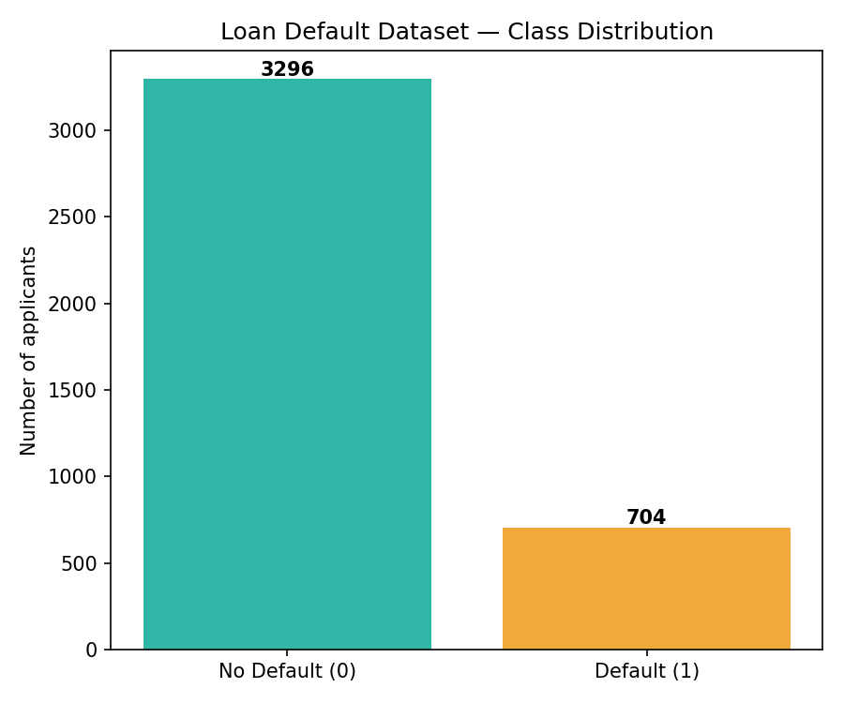
1. DATASET
Loan Default Prediction — Finance Domain
4,000 applicants • 9 features • Default rate: 17.6%
01

Slide 3
2
Data Validation
Techniques
Train/Test Split vs. TimeSeriesSplit

Slide 4
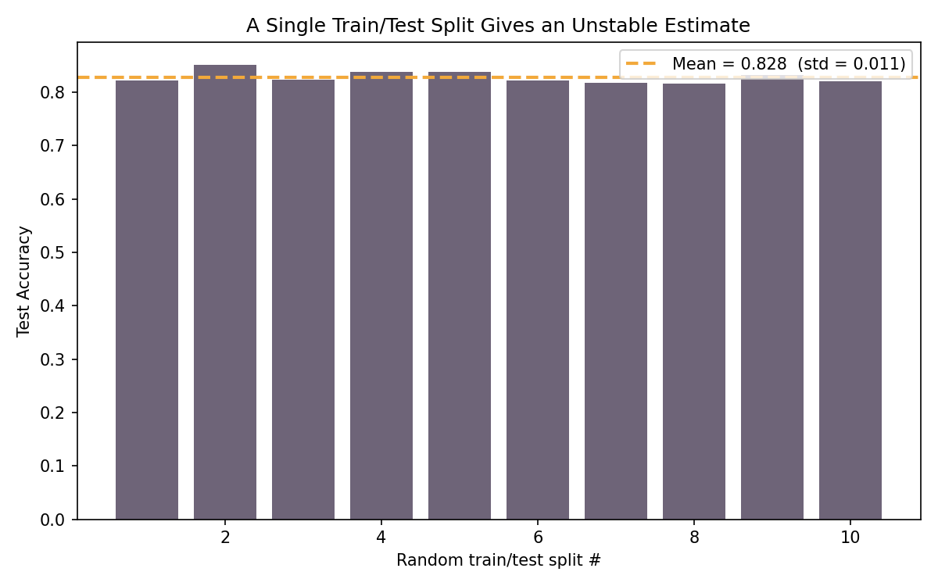
2.1 DATA VALIDATION
What Is Train/Test Split?
The simplest validation method: split the dataset ONCE into a training portion (e.g. 80%) and a test portion (e.g. 20%). Train on one, evaluate on the other.
Fast and easy to implement
Only gives ONE accuracy estimate — based on whichever rows randomly land in the test set
Risk: a "lucky" or "unlucky" split can make a model look better or worse than it really is
02

Slide 5
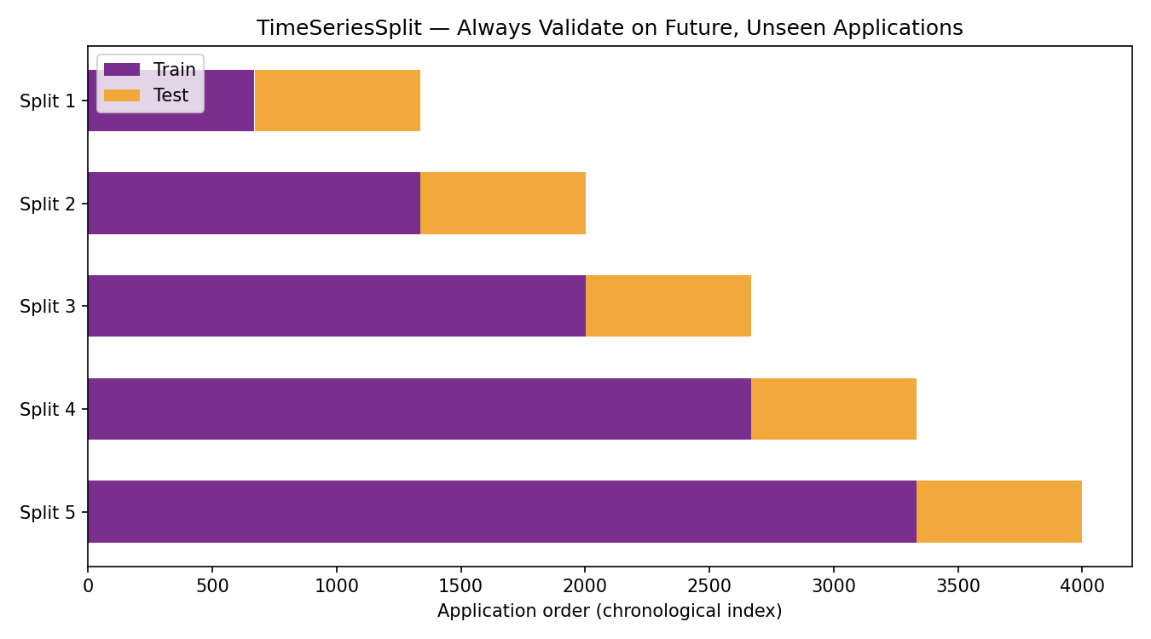
2.2 DATA VALIDATION
What Is TimeSeriesSplit?
A validation technique made for chronological data. Instead of one random split, it creates multiple splits where the training window grows over time and the test set is always the NEXT chunk of future data.
Never trains on future data to predict the past — avoids data leakage
Mimics how the model will actually be used: trained on history, applied to new applications
Produces multiple accuracy scores (one per fold) instead of just one
Essential for finance data with a timestamp/application order
04

Slide 6
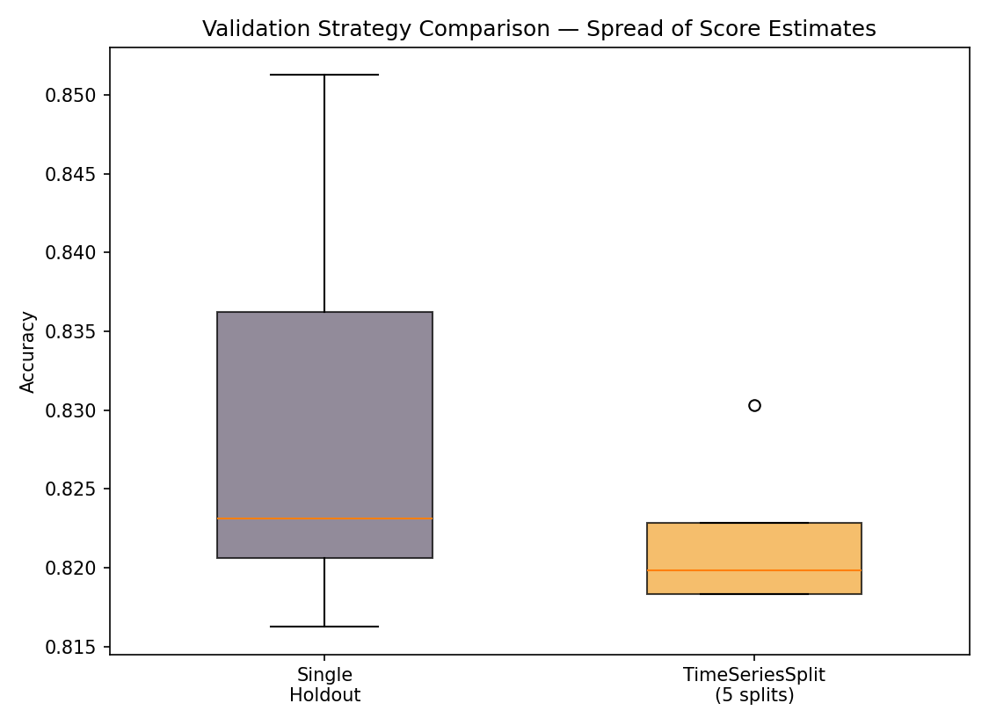
2.3 COMPARING VALIDATION STRATEGIES
Which Gives a More Reliable Estimate?
06

Slide 7
3
Overfitting vs.
Underfitting
Finding the Right Model Complexity

Slide 8
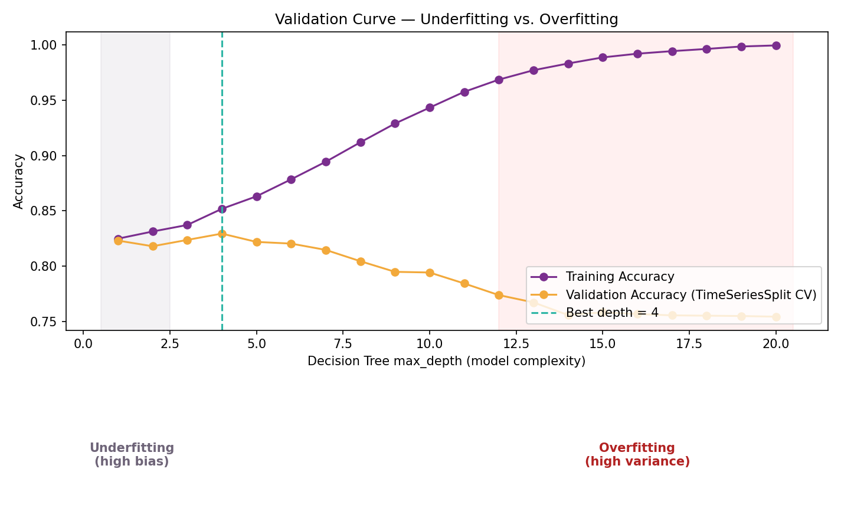
3. MODEL FIT
Underfitting
The model is too SIMPLE to learn the real pattern in the data.
Signature: LOW accuracy on BOTH training and test data
Cause: model too simple (e.g. shallow tree, too few features)
Finance example: a depth=1 tree misses real credit-risk patterns
07

Slide 9
3. MODEL FIT
Overfitting
The model is too COMPLEX and starts memorizing noise instead of the true pattern.
Signature: HIGH training accuracy but LOW test accuracy (a big gap)
Cause: model too complex (very deep tree, too many features)
Finance example: a depth=20 tree perfectly memorizes past applicants but fails on new ones
08

Slide 10
3.1 VALIDATION CURVE — EVIDENCE
Decision Tree Depth vs. Accuracy
09

Slide 11
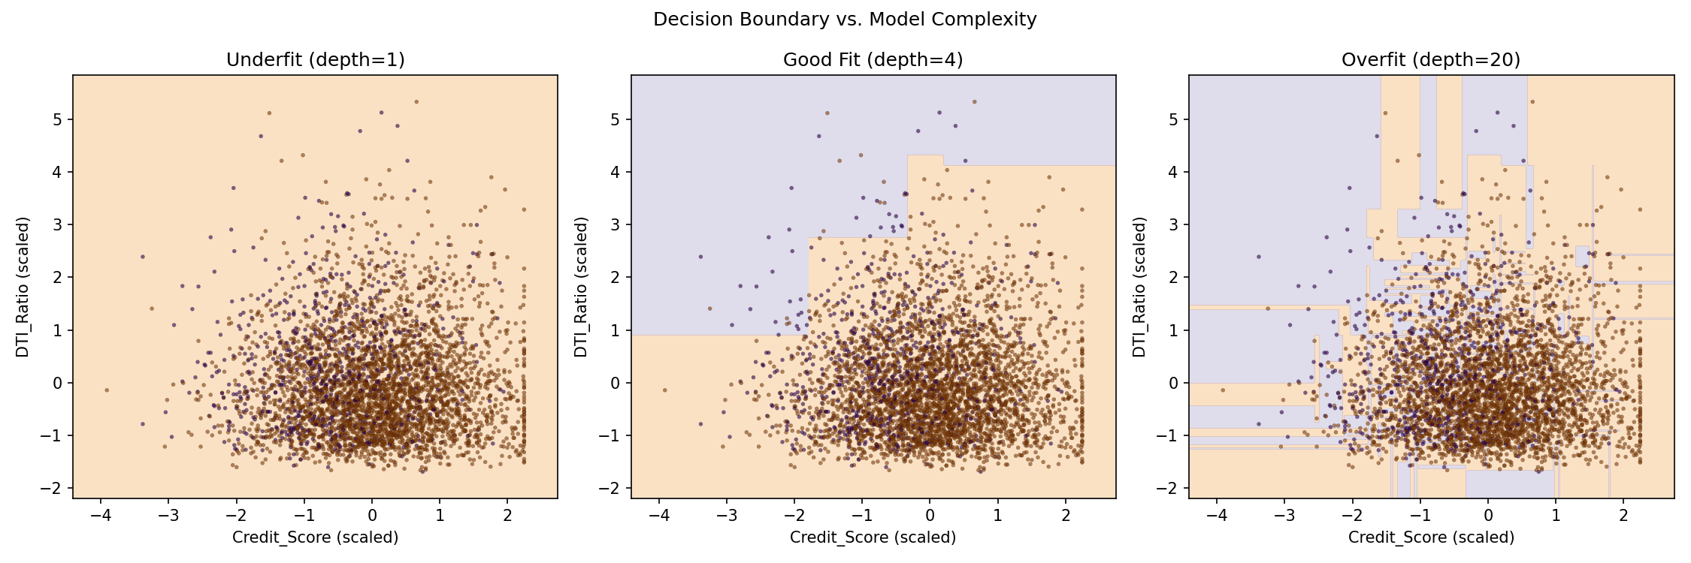
3.2 SEEING IT DIRECTLY
Decision Boundaries at Each Complexity
10

Slide 12
KEY TAKEAWAYS
Summary
1
A single Train/Test split can give an unstable, misleading accuracy estimate
2
TimeSeriesSplit respects chronological order — always test on future, unseen data
3
Underfitting = high bias (too simple) | Overfitting = high variance (too complex)
Thank You

